Slide 1
A Simple Profile Website
By Ahmed Mohammed Alkali

Slide 2
Presentation Content
Website overview
Website Sections
CSS overview
JavaScript overview
Conclusion

Slide 3
Website Overview
The Site is a simple, yet stylish website that showcases my personal and professional background.
The website has a clean layout and is easy to navigate with a menu that directs visitors to different sections of the site.
The site features a homepage, an "About Me" section, a "Hobbies" section, an "Education" section, and a "Contact" section.
The site also includes a "My Data" button in the "About Me" section that displays some additional information about me And a " My Skills " button in the " Education section ".

Slide 4
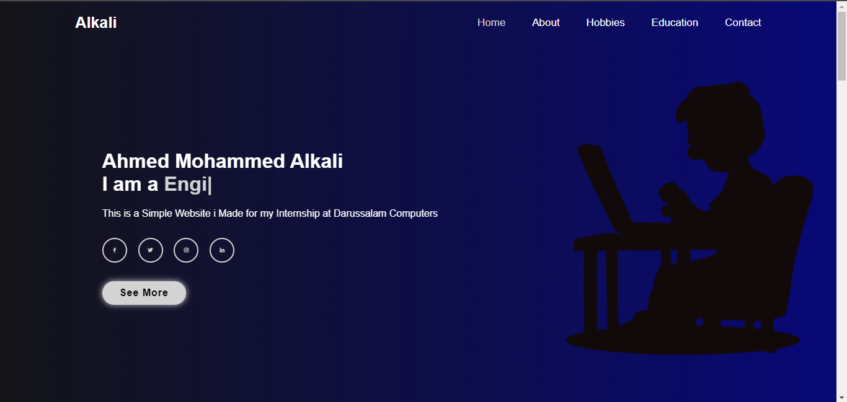
The Home Page
The homepage of My Site features a banner image and a brief introduction about me.
The homepage also includes links to my social media profiles and a button that directs visitors to the "About Me" section of the site.

Slide 5
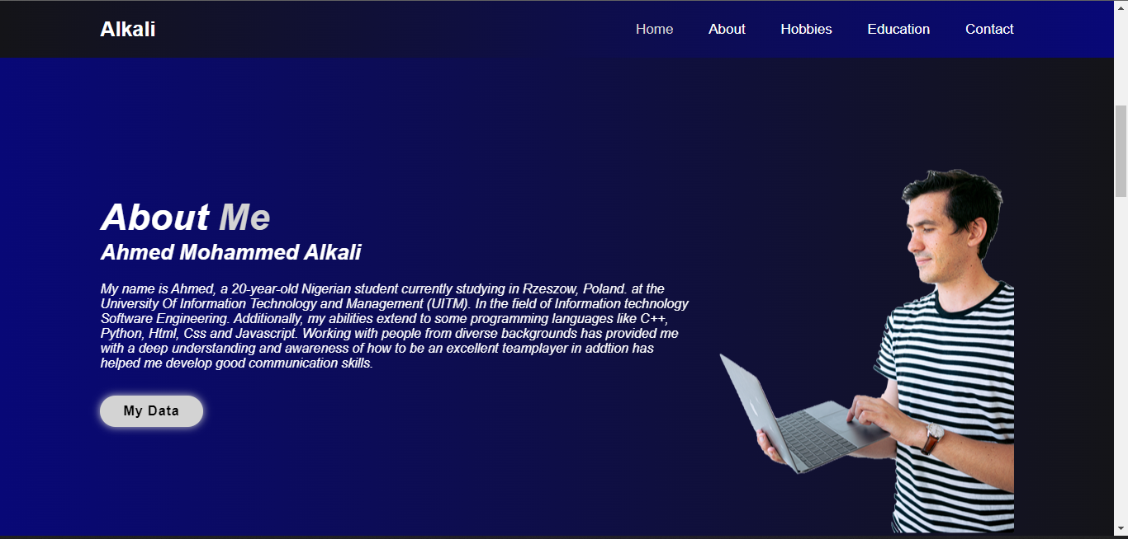
About Me
The "About Me" section of My Site provides a more detailed overview of my personal and professional background.
This section includes a Random picture, a brief introduction, and a description of my skills and abilities.
The "My Data" button in this section displays additional information about me, such as my email address and phone number.

Slide 6
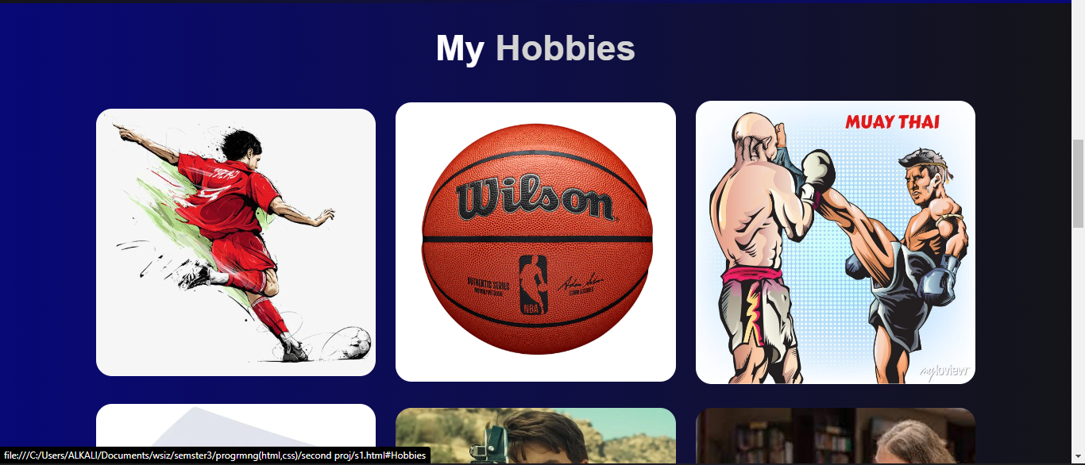
Hobbies
The "Hobbies" section of My Site showcases some of my favorite hobbies, including football, basketball, boxing, gaming, movies & series, and reading.
Each hobby is displayed in a box with an image using a hover effect a title is displayed.

Slide 7
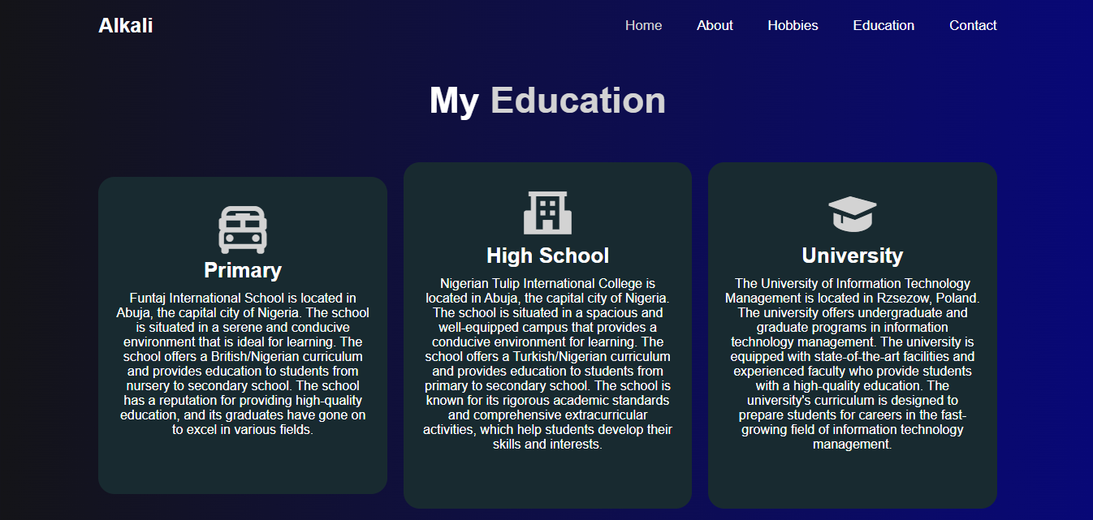
My Education
The "Education" section of Ahmad's Site provides an overview of my educational background.
This section includes information about my primary school, secondary school, and current university.
At the bottom of the page is a skills button that displays a progress bar of the skills I posses.

Slide 8
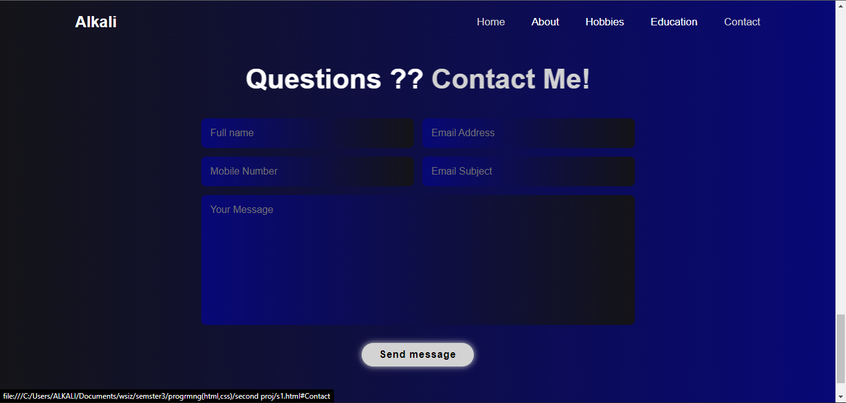
Contact
The "Contact" section of My Site provides visitors with a way to get in touch with me.
This section includes a contact form where visitors can enter their name, email address, and message.

Slide 9
CSS Overview
The * selector sets default styles for all HTML elements.
The :root selector defines global CSS variables.
The html selector sets the font size to 62.5% and hides horizontal scroll bars.
The body selector sets the background color and text color for the entire page.
The section selector sets a minimum height and padding for all sections.
The .header selector sets a fixed position header at the top of the page with a logo, navigation links, and a sticky class that applies a border when scrolling.
The .logo and .navbar a selectors set styles for the header logo and navigation links.
The #mmain selector hides an element with the ID "mmain".

Slide 10
Continuation
The .home selector centers content on the home page and applies an animation to an image.
The .home-content selector sets styles for text content on the home page.
The .social-media a and .btn selectors style social media links and buttons respectively.
The button selector styles all button elements.
The .about selector sets styles for the about section of the page.
The .abcont selector styles text content within the about section.
The #info selector styles an element with the ID "info".
The .Hobbies selector sets styles for the hobbies section of the page.

Slide 11
The CSS Animation
The animation is called floatImage and has three keyframes (at 0%, 50%, and 100%) with different transform values applied to the element at each keyframe.
The animation is applied to the .himg element using the animation property, which specifies the animation name (floatImage), the animation duration (4 seconds), the timing function (ease-in-out), and that the animation should repeat indefinitely (infinite).
When the animation is applied, the .himg element will move up and down by 2.4rem (about 38 pixels) in a repeating animation loop.
Float image

Slide 12
JS Overview
Typed.js: This is a library that enables the creation of a typing effect on a webpage. In this code, it is used to create a typewriter effect that types out several strings one after the other.
ShowInfo(): This function is called when a button is clicked on the webpage. It populates a table with personal information such as name, birthday, nationality, phone number, city, school, degree, email, and occupation.
ToggleSkills(): This function toggles the display of a skills section on the webpage. When the function is called, it checks the current display style of the skills section. If it is set to "none", the function changes it to "block". If it is set to "block", the function changes it to "none".
ScrollReveal(): This is also a library that adds a scroll animation to a webpage. It is used to reveal certain elements of the webpage as the user scrolls down. The distance, duration, and delay properties are set for the animation to control the speed and timing of the reveal. The reveal() function is used to specify which elements should have the scroll animation, and the origin property is used to set the direction from which the elements should appear.

Slide 13
Conclusion
Thank you for taking the time to learn more about My Site. I hope you found the website informative and engaging.

